Slide 1
Orders of Growth
26年 11月 8日
©2001-2004 Michael P. Frank, revised by S. Kang
Notes:
Discrete Mathematics and its Applications
26年 11月 8日
(c)2001-2002, Michael P. Frank

Slide 2
Algorithmic Complexity
The algorithmic complexity of a computation is, most generally, a measure of how difficult it is to perform the computation.
That is, it measures some aspect of the cost of computation (in a general sense of “cost”).
  Amount of resources required to do a computation.
Some of the most common complexity measures:
  “Time” complexity: # of operations or steps required
  “Space” complexity: # of memory bits req’d
Our focus
26年 11月 8日
©2001-2004 Michael P. Frank, revised by S. Kang

Slide 3
Complexity Depends on Input
Most algorithms have different complexities for inputs of different sizes.
  E.g. searching a long list typically takes more time than searching a short one.
Therefore, complexity is usually expressed as a function of the input length.
  This function usually gives the complexity for the worst-case input of any given length.
26年 11月 8日
©2001-2004 Michael P. Frank, revised by S. Kang

Slide 4
Orders of Growth
For functions over numbers, we often need to know a rough measure of how fast a function grows.
If f(x) is faster growing than g(x), then f(x) always eventually becomes larger than g(x) in the limit (for large enough values of x).
Useful in engineering for showing that one design scales better or worse than another.
26年 11月 8日
©2001-2004 Michael P. Frank, revised by S. Kang

Slide 5
Orders of Growth - Motivation
Suppose you are designing a web site to process user data (e.g., financial records).
Suppose database program A takes f_{A}(n)=30n+8 microseconds to process any n records, while program B takes f_{B}(n)=n²+1 microseconds to process the n records.
Which program do you choose, knowing you’ll want to support millions of users?
A
26年 11月 8日
©2001-2004 Michael P. Frank, revised by S. Kang

Slide 6
Visualizing Orders of Growth
On a graph, as
you go to the
right, the faster-
growing func-
tion always
eventually
becomes the
larger one...
f_{A}(n)=30n+8
Value of function →
f_{B}(n)=n²+1
Increasing n →
26年 11月 8日
©2001-2004 Michael P. Frank, revised by S. Kang

Slide 7
Concept of order of growth
We say f_{A}(n)=30n+8 is (at most) order n, or O(n).
  It is, at most, roughly proportional to n.
f_{B}(n)=n²+1 is order n², or O(n²).
  It is (at most) roughly proportional to n².
Any function whose exact (tightest) order is O(n²) is faster-growing than any O(n) function.
  Later we will introduce Θ for expressing exact order.
For large numbers of user records, the exactly order n² function will always take more time.
26年 11月 8日
©2001-2004 Michael P. Frank, revised by S. Kang

Slide 8
Definition: O(g), at most order g
Let g be any function R→R.
Define “at most order g”, written O(g), to be: {f:R→R | ∃c,k: ∀x>k: f(x) ≤ cg(x)}.
  “Beyond some point k, function f is at most a constant c times g (i.e., proportional to g).”
“f is at most order g”, or “f is O(g)”, or “f=O(g)” all just mean that f∈O(g).
Often the phrase “at most” is omitted.
26年 11月 8日
©2001-2004 Michael P. Frank, revised by S. Kang

Slide 9
Points about the definition
Note that f is O(g) so long as any values of c and k exist that satisfy the definition.
But: The particular c, k, values that make the statement true are not unique: Any larger value of c and/or k will also work.
You are not required to find the smallest c and k values that work. (Indeed, in some cases, there may be no smallest values!)
However, you should prove that the values you choose do work.
26年 11月 8日
©2001-2004 Michael P. Frank, revised by S. Kang

Slide 10
“Big-O” Proof Examples
Show that 30n+8 is O(n).
  Show ∃c,k: ∀n>k: 30n+8 ≤ cn.
    Let c=31, k=8. Assume n>k=8. Then
    cn = 31n = 30n + n > 30n+8, so 30n+8 ≤ cn.
Show that n²+1 is O(n²).
  Show ∃c,k: ∀n>k: n²+1 ≤ cn².
    Let c=2, k=1. Assume n>1. Then
    cn² = 2n² = n²+n² > n²+1, or n²+1 ≤ cn².
26年 11月 8日
©2001-2004 Michael P. Frank, revised by S. Kang

Slide 11
Big-O example, graphically
Note 30n+8 isn’t
less than n
anywhere (n>0).
But it is less than
31n everywhere to
the right of n=8.
cn =
31n
30n+8
30n+8
∈O(n)
Value of function →
n
n>k=8 →
Increasing n →
26年 11月 8日
©2001-2004 Michael P. Frank, revised by S. Kang

Slide 12
Useful Facts about Big O
Big O, as a relation, is transitive:
f∈O(g) ∧ g∈O(h) → f∈O(h)
O with constant multiples, roots, and logs...
∀ f (≠ const.) & constants a,b∈R, with b≥0,
af, f ^{1-b}, and (log_{b} f)ª are all O(f).
Sums of functions:
If g∈O(f) and h∈O(f), then g+h∈O(f).
26年 11月 8日
©2001-2004 Michael P. Frank, revised by S. Kang

Slide 13
More Big-O facts
∀c>0, O(cf)=O(f+c)=O(f−c)=O(f)
f₁∈O(g₁) ∧ f₂∈O(g₂) →
  f₁ f₂ ∈O(g₁g₂)
  f₁+f₂ ∈O(g₁+g₂)
  = O(max(g₁,g₂))
  = O(g₁) if g₂∈O(g₁) (Very useful!)
26年 11月 8日
©2001-2004 Michael P. Frank, revised by S. Kang

Slide 14
Order-of-Growth Expressions
“O(f)” when used as a term in an arithmetic expression means: “some function f such that f∈O(f)”.
E.g.: “x²+O(x)” means “x² plus some function that is O(x)”.
Formally, you can think of any such expression as denoting a set of functions: x²+O(x) :≡ {g | ∃f∈O(x): g(x)= x²+f(x)}
26年 11月 8日
©2001-2004 Michael P. Frank, revised by S. Kang

Slide 15
Order of Growth Equations
Suppose E₁ and E₂ are order-of-growth expressions corresponding to the sets of functions S and T, respectively.
Then the “equation” E₁=E₂ really means
∀f∈S, ∃g∈T : f=g
or simply S⊆T.
Example: x² + O(x) = O(x²) means
∀f∈O(x): ∃g∈O(x²): x²+f(x)=g(x)
26年 11月 8日
©2001-2004 Michael P. Frank, revised by S. Kang

Slide 16
Useful Facts about Big O
∀ f,g & constants a,b∈R, with b≥0,
  af = O(f); (e.g. 3x² = O(x²))
  f+O(f) = O(f); (e.g. x²+x = O(x²))
Also, if f=Ω(1) (at least order 1), then:
  |f|^{1-b} = O(f); (e.g. x⁻¹ = O(x))
  (log_{b} |f|)ª = O(f). (e.g. log x = O(x))
  g=O(fg) (e.g. x = O(x log x))
  fg ≠ O(g) (e.g. x log x ≠ O(x))
  a=O(f) (e.g. 3 = O(x))
26年 11月 8日
©2001-2004 Michael P. Frank, revised by S. Kang

Slide 17
Definition: Θ(g), exactly order g
If f∈O(g) and g∈O(f), then we say “g and f are of the same order” or “f is (exactly) order g” and write f∈Θ(g).
Another, equivalent definition:
Θ(g) ≡ {f:R→R |
∃c₁c₂k>0 ∀x>k: |c₁g(x)|≤|f(x)|≤|c₂g(x)| }
  “Everywhere beyond some point k, f(x) lies in between two multiples of g(x).”
26年 11月 8日
©2001-2004 Michael P. Frank, revised by S. Kang

Slide 18
Rules for Θ
Mostly like rules for O( ), except:
∀ f,g>0 & constants a,b∈R, with b>0,
af ∈ Θ(f), but ← Same as with O.
f ∉ Θ(fg) unless g=Θ(1) ← Unlike O.
|f| ^{1-b} ∉ Θ(f), and ← Unlike with O.
(log_{b} |f|)^{c} ∉ Θ(f). ← Unlike with O.
The functions in the latter two cases we say are strictly of lower order than Θ(f).
26年 11月 8日
©2001-2004 Michael P. Frank, revised by S. Kang

Slide 19
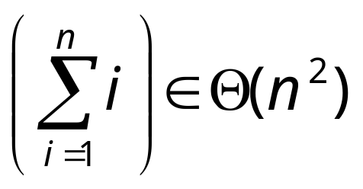
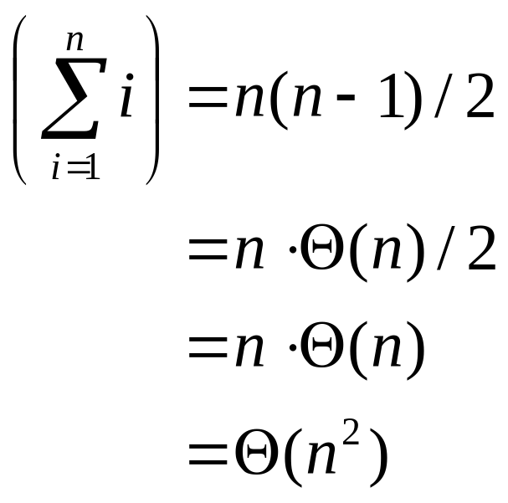
Θ example
Determine whether:
Quick solution:
26年 11月 8日
©2001-2004 Michael P. Frank, revised by S. Kang

Slide 20
Other Order-of-Growth Relations
Ω(g) = {f | g∈O(f)}
“The functions that are at least order g.”
o(g) = {f | ∀c>0 ∃k ∀x>k : |f(x)| < |cg(x)|}
“The functions that are strictly lower order than g.” o(g) ⊂ O(g) − Θ(g).
ω(g) = {f | ∀c>0 ∃k ∀x>k : |cg(x)| < |f(x)|}
“The functions that are strictly higher order than g.” ω(g) ⊂ Ω(g) − Θ(g).
26年 11月 8日
©2001-2004 Michael P. Frank, revised by S. Kang

Slide 21
Relations Between the Relations
Subset relations between order-of-growth sets.
R→R
O( f )
Ω( f )
• f
o( f )
Θ( f )
ω( f )
26年 11月 8日
©2001-2004 Michael P. Frank, revised by S. Kang

Slide 22
Why o(f)⊂O(f)−Θ(f)
A function that is O(f), but neither o(f) nor Θ(f):
26年 11月 8日
©2001-2004 Michael P. Frank, revised by S. Kang

Slide 23
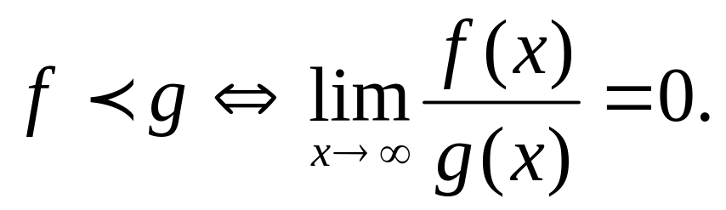
Strict Ordering of Functions
Temporarily let’s write fg to mean f∈o(g),
f~g to mean f∈Θ(g)
Note that:
Let k>1. Then the following are true:
1  log log n  log n ~ log_{k} n  log^{k} n
❐ n^{1/k}  n  n log n  n^{k}  k^{n}  n!  n^{n} …
26年 11月 8日
©2001-2004 Michael P. Frank, revised by S. Kang

Slide 24
Algorithmic Complexity
26年 11月 8日
©2001-2004 Michael P. Frank, revised by S. Kang

Slide 25
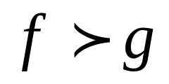
Complexity & Orders of Growth
Suppose algorithm A has worst-case time complexity (w.c.t.c., or just time) f(n) for inputs of length n, while algorithm B (for the same task) takes time g(n).
Suppose that f∈ω(g), also written .
Which algorithm will be fastest on all sufficiently-large, worst-case inputs?
B
26年 11月 8日
©2001-2004 Michael P. Frank, revised by S. Kang

Slide 26
Example 1: Max algorithm
Problem: Find the simplest form of the exact order of growth (Θ) of the worst-case time complexity (w.c.t.c.) of the max algorithm, assuming that each line of code takes some constant time every time it is executed (with possibly different times for different lines of code).
26年 11月 8日
©2001-2004 Michael P. Frank, revised by S. Kang

Slide 27
Complexity analysis of max
procedure max(a₁, a₂, …, a_{n}: integers)
v := a₁ t₁
for i := 2 to n t₂
if a_{i} > v then v := a_{i} t₃
return v t₄
First, what’s an expression for the exact total worst-case time? (Not its order of growth.)
Times for each execution of each line.
26年 11月 8日
©2001-2004 Michael P. Frank, revised by S. Kang

Slide 28
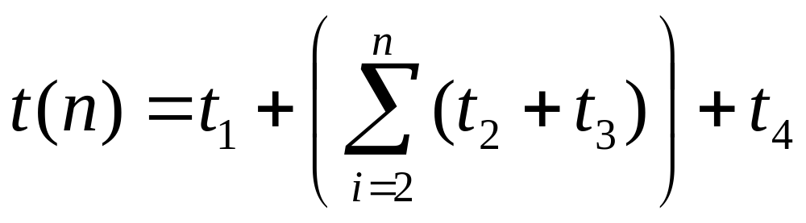
Complexity analysis, cont.
procedure max(a₁, a₂, …, a_{n}: integers)
v := a₁ t₁
for i := 2 to n t₂
if a_{i} > v then v := a_{i} t₃
return v t₄
w.c.t.c.:
Times for each execution of each line.
26年 11月 8日
©2001-2004 Michael P. Frank, revised by S. Kang

Slide 29
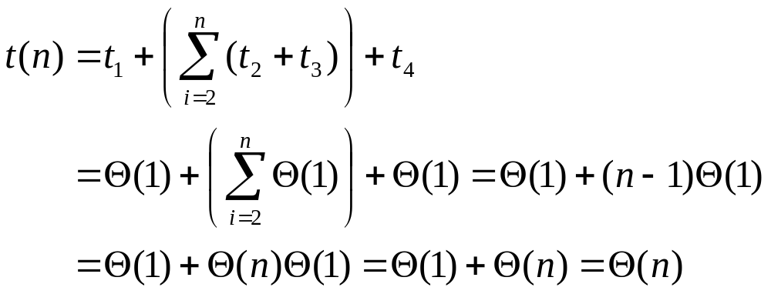
Complexity analysis, cont.
Now, what is the simplest form of the exact (Θ) order of growth of t(n)?
26年 11月 8日
©2001-2004 Michael P. Frank, revised by S. Kang

Slide 30
Example 2: Linear Search
procedure linear search (x: integer,
a₁, a₂, …, a_{n}: distinct integers)
i := 1 t₁
while (i ≤ n ∧ x ≠ a_{i}) t₂
i := i + 1 t₃
if i ≤ n then location := i t₄
else location := 0 t₅
return location t₆
26年 11月 8日
©2001-2004 Michael P. Frank, revised by S. Kang

Slide 31
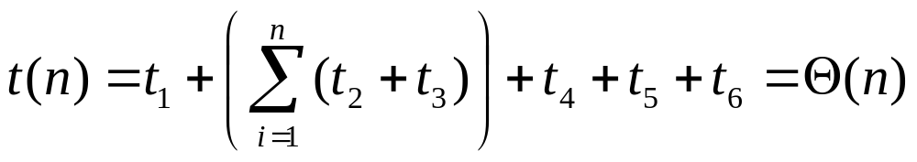
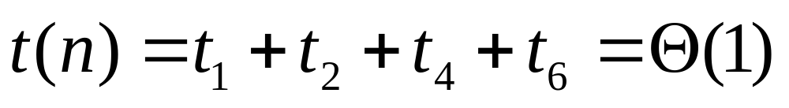
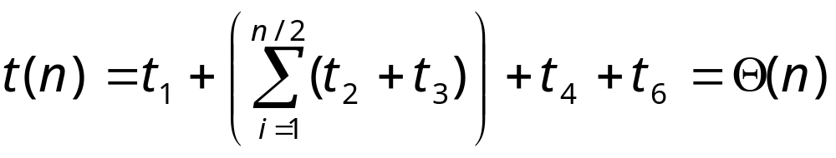
Linear search analysis
Worst case time complexity order:
Best case:
Average case, if item is present:
26年 11月 8日
©2001-2004 Michael P. Frank, revised by S. Kang

Slide 32
Example 3: Binary Search
procedure binary search (x:integer, a₁, a₂, …, a_{n}: distinct integers, sorted smallest to largest)
i := 1
j := n
while i<j begin
m := ⎣(i+j)/2⎦
if x>a_{m} then i := m+1 else j := m
end
if x = a_{i} then location := i else location := 0
return location
Key question:
How many loop iterations?
Θ(1)
Θ(1)
Θ(1)
26年 11月 8日
©2001-2004 Michael P. Frank, revised by S. Kang

Slide 33
Binary search analysis
Suppose that n is a power of 2, i.e., ∃k: n=2^{k}.
Original range from i=1 to j=n contains n items.
Each iteration: Size j−i+1 of range is cut in ~half.
Loop terminates when size of range is 1=2⁰ (i=j).
Therefore, the number of iterations is:
k = log₂n = Θ(log₂ n)= Θ(log n)
Even for n≠2^{k} (not an integral power of 2),
time complexity is still Θ(log₂ n) = Θ(log n).
26年 11月 8日
©2001-2004 Michael P. Frank, revised by S. Kang

Slide 34
Names for some orders of growth
Θ(1) Constant
Θ(log_{c} n) Logarithmic (same order ∀c)
Θ(log^{c} n) Polylogarithmic
Θ(n) Linear
Θ(n^{c}) Polynomial (for any c)
Θ(c^{n}) Exponential (for c>1)
Θ(n!) Factorial
(With c
a constant.)
26年 11月 8日
©2001-2004 Michael P. Frank, revised by S. Kang

Slide 35
Problem Complexity
The complexity of a computational problem or task is (the order of growth of) the complexity of the algorithm with the lowest order of growth of complexity for solving that problem or performing that task.
E.g. the problem of searching an ordered list has at most logarithmic time complexity. (Complexity is O(log n).)
26年 11月 8日
©2001-2004 Michael P. Frank, revised by S. Kang

Slide 36
Tractable vs. intractable
A problem or algorithm with at most polynomial time complexity is considered tractable (or feasible). P is the set of all tractable problems.
A problem or algorithm that has complexity greater than polynomial is considered intractable (or infeasible).
Note that n^{1,000,000} is technically tractable, but really very hard. n^{log log log n} is technically intractable, but easy. Such cases are rare though.
26年 11月 8日
©2001-2004 Michael P. Frank, revised by S. Kang

Slide 37
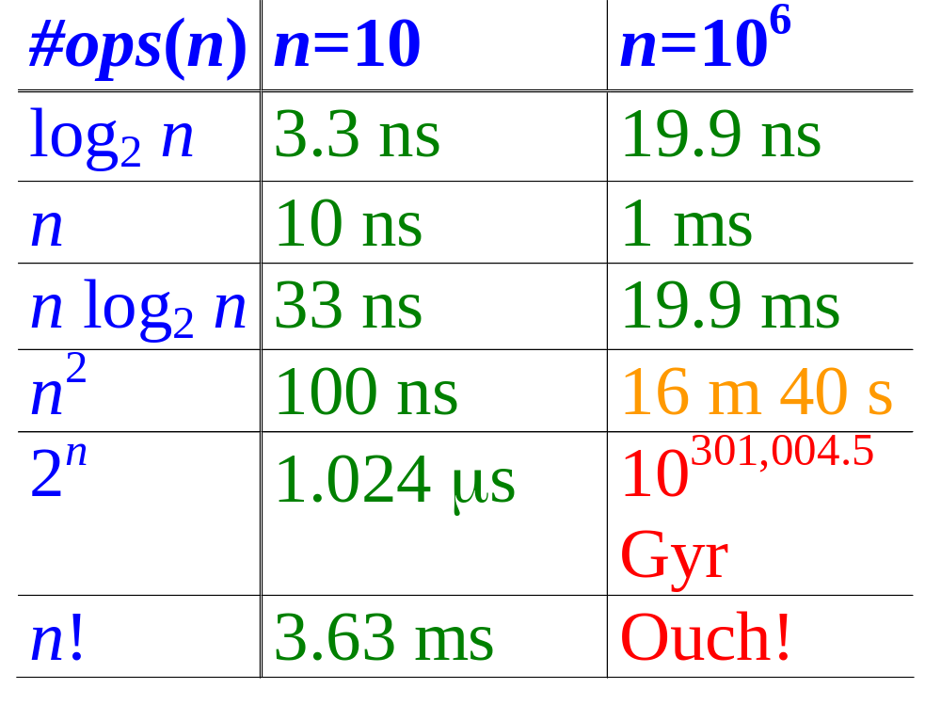
Computer Time Examples
(1.25 bytes)
(125 kB)
Assume time = 1 ns (10⁻⁹ second) per op, problem size = n bits, and #ops is a function of n, as shown.
26年 11月 8日
©2001-2004 Michael P. Frank, revised by S. Kang

Slide 38
P vs. NP
NP is the set of problems for which there exists a tractable algorithm for checking a proposed solution to tell if it is correct.
We know that P⊆NP, but the most famous unproven conjecture in computer science is that this inclusion is proper.
  i.e., that P⊂NP rather than P=NP.
Whoever first proves this will be famous!
(or disproves it!)
26年 11月 8日
©2001-2004 Michael P. Frank, revised by S. Kang

Slide 39
Key Things to Know
Definitions of algorithmic complexity, time complexity, worst-case time complexity.
Names of specific orders of growth of complexity.
How to analyze the worst case, best case, or average case order of growth of time complexity for simple algorithms.
26年 11月 8日
©2001-2004 Michael P. Frank, revised by S. Kang

Slide 40
Recommended Exercises
Exercises of Section 3.2
  1, 7, 21
Exercises of Section 3.3
  7, 9, 13
26年 11月 8日
©2001-2004 Michael P. Frank, revised by S. Kang

